Slide 1
Unsupervised Learning
Daniele Marazzina
Politecnico di Milano

Slide 2
Unsupervised Learning
In unsupervised learning we are not trying to predict anything
The objective is to cluster data to increase our understanding of the environment
How? With the k-means algorithm

Slide 3
Example: Clustering Customers
Suppose you are a bank and have hundreds of thousands of customers and 100 features describing each one
Unsupervised learning algorithms can be used to divide your customers into clusters so that you can anticipate their needs and communicate with them more effectively

Slide 4
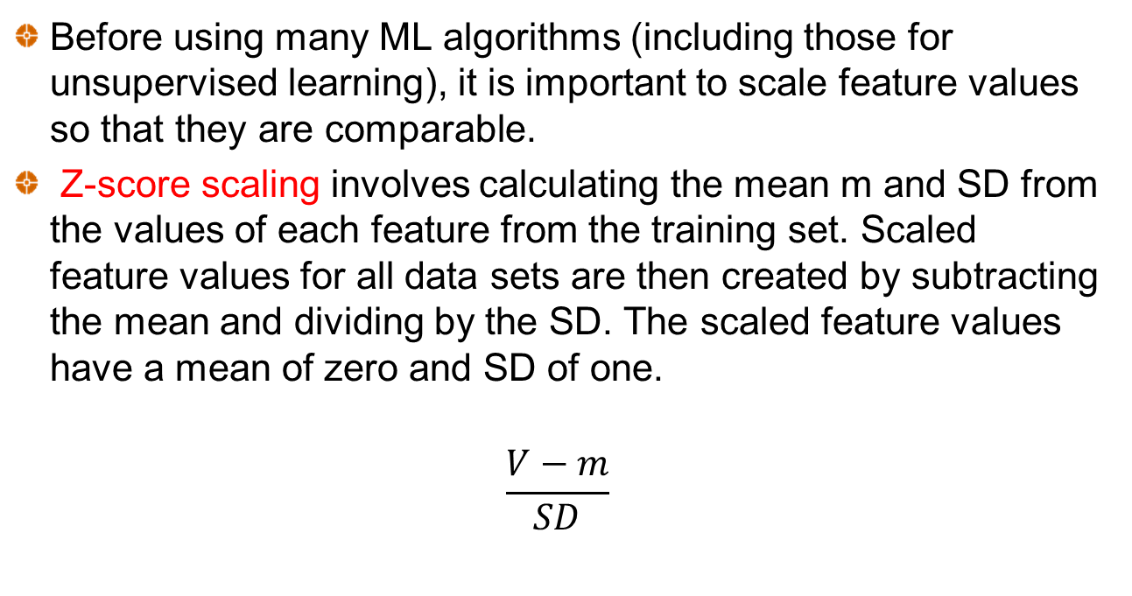
Feature Scaling
Before using many ML algorithms (including those for unsupervised learning), it is important to scale feature values so that they are comparable.
Z-score scaling involves calculating the mean m and SD from the values of each feature from the training set. Scaled feature values for all data sets are then created by subtracting the mean and dividing by the SD. The scaled feature values have a mean of zero and SD of one.
$$\frac{V−m}{SD}$$

Slide 5
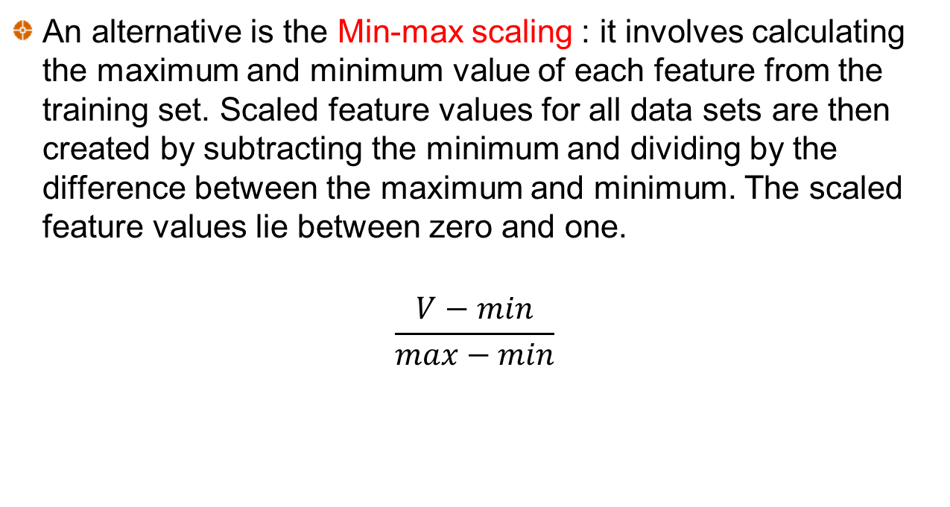
Feature Scaling
An alternative is the Min-max scaling : it involves calculating the maximum and minimum value of each feature from the training set. Scaled feature values for all data sets are then created by subtracting the minimum and dividing by the difference between the maximum and minimum. The scaled feature values lie between zero and one.
$$\frac{V−min}{max−min}$$

Slide 6
A Distance Measure
For clustering we need a distance measure
The simplest distance measure is the Euclidean distance measure. Distance =

Slide 7
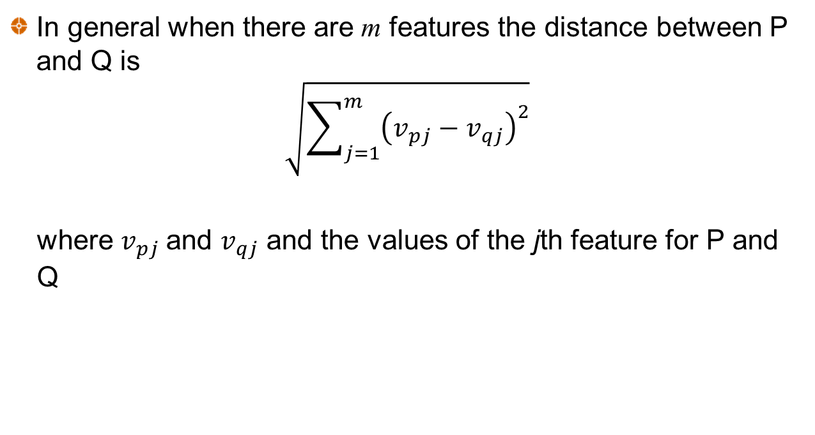
Distance Measure continued
In general when there are m features the distance between P and Q is
$$\sqrt{\sum_{j=1}^{m}{{\left(v_{pj}−v_{qj}\right)}^{2}}}$$
where $v_{pj}$and $v_{qj}$ and the values of the jth feature for P and Q
Now that we have a distance measure, it is important to define the center of a cluster, also known as cluster centroid

Slide 8
Cluster Centers
The center of a cluster is determined by averaging the values of each feature for all points in the cluster. Example:
Observ. | Feature 1 | Feature 2 | Feature 3 | Feature 4 | Distance to center
1 | 1.00 | 1.00 | 0.40 | 0.25 | 0.145
2 | 0.80 | 1.20 | 0.25 | 0.40 | 0.258
3 | 0.82 | 1.05 | 0.35 | 0.50 | 0.206
4 | 1.10 | 0.80 | 0.21 | 0.23 | 0.303
5 | 0.85 | 0.90 | 0.37 | 0.27 | 0.137
Center | 0.914 | 0.990 | 0.316 | 0.330

Slide 9
k-means algorithm to find k clusters
Choose k random points as cluster centers
Assign each observation to nearest cluster center
Calculate new cluster centers
End
Have cluster centers changed?
No
Yes

Slide 10
Inertia
For any given k the objective is to minimize inertia, which is defined as the within cluster sum of squares:
where d_{i} is the distance of observation i from its cluster center,
and n is the number of observations
In practice we use the k-means algorithm with several different starting points and choose the result that has the smallest inertia
Generally, the inertia decreases as k increases, approaching 0 when k=n, i.e., we have n observations and n clusters, i.e., each cluster coincide with a single observation.
Therefore we need to find a proper way to set k

Slide 11
Choosing k
The elbow approach
In this case, k=4 seems the best choice, since the inertia decreases of a small quantity moving from 4 to 5 w.r.t from 3 to 4

Slide 12
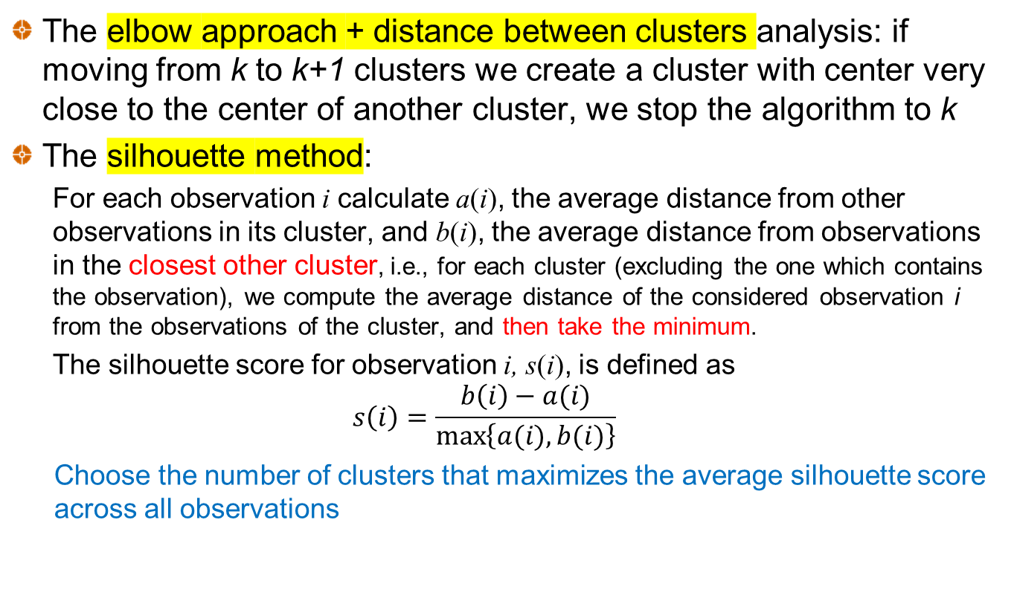
Choosing k
The elbow approach + distance between clusters analysis: if moving from k to k+1 clusters we create a cluster with center very close to the center of another cluster, we stop the algorithm to k
The silhouette method:
For each observation i calculate a(i), the average distance from other observations in its cluster, and b(i), the average distance from observations in the closest other cluster, i.e., for each cluster (excluding the one which contains the observation), we compute the average distance of the considered observation i from the observations of the cluster, and then take the minimum.
The silhouette score for observation i, s(i), is defined as
$$s\left(i\right)=\frac{b\left(i\right)−a(i)}{\max\left\{a(i),b(i)\right\}}$$
Choose the number of clusters that maximizes the average silhouette score across all observations

Slide 13
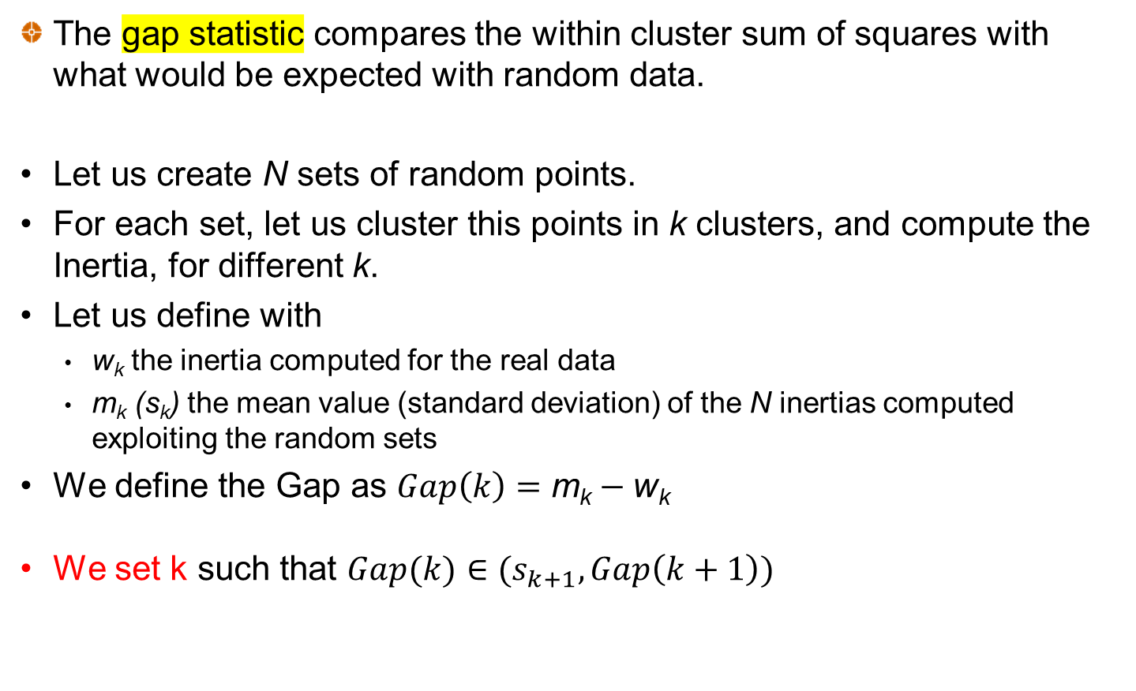
Choosing k
The gap statistic compares the within cluster sum of squares with what would be expected with random data.
Let us create N sets of random points.
For each set, let us cluster this points in k clusters, and compute the Inertia, for different k.
Let us define with
w_{k} the inertia computed for the real data
m_{k} (s_{k}) the mean value (standard deviation) of the N inertias computed exploiting the random sets
We define the Gap as $Gap\left(k\right)=\text{m}\text{k}−\text{w}\text{k}$
We set k such that $Gap(k)∈(s_{k+1},Gap\left(k+1\right))$

Slide 14
The Curse of Dimensionality
The Euclidean distance measure increases as the number of features increase.
This is referred to as the curse of dimensionality, and could prevent the k-means algorithm to work efficiently.
Consider two observations that have values for feature j equal to x_{j} and y_{j}. An alternative distance measure that always lies between 0 and 2 is

Slide 15
An example: Country Risk Case
Objective is to cluster countries according to their riskiness for foreign investment
Measures of Country Risk
GDP growth rate (IMF)
Corruption index (Transparency international)
Peace index (Institute for Economics and Peace)
Legal Risk Index (Property Rights Association)
Collected data on 122 countries. Used Z-score scaling.
Python code - © J.Hull – Machine Learning in business

Slide 16
Corruption and legal risk were highly correlated
Therefore analysis based on
GDP growth rate
Peace index
Legal risk index
Legal
Corruption

Slide 17
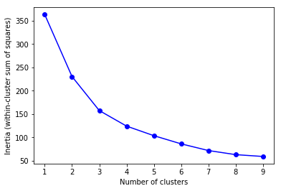
How the total within-cluster sum of squares declines as k increases when k-means algorithm is used

Slide 18
Silhouette scores (suggest k=3)
Number of clusters | Average silhouette score
2 | 0.363
3 | 0.388
4 | 0.370
5 | 0.309
6 | 0.303
7 | 0.315
8 | 0.321
9 | 0.292
10 | 0.305

Slide 19
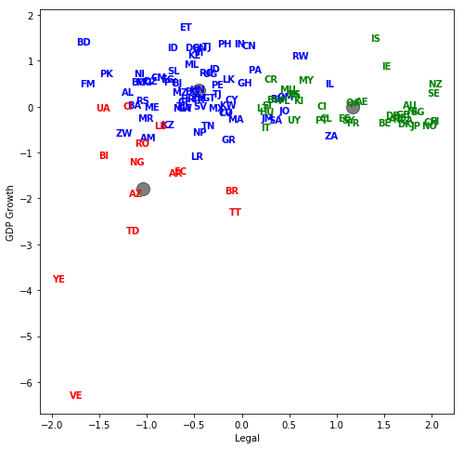
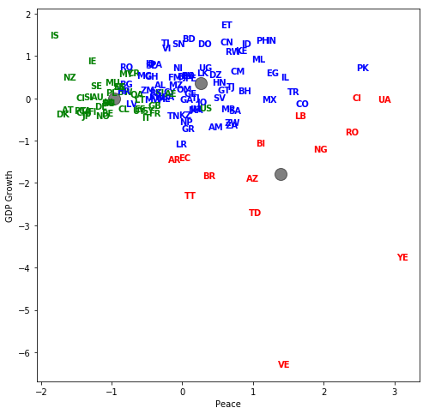
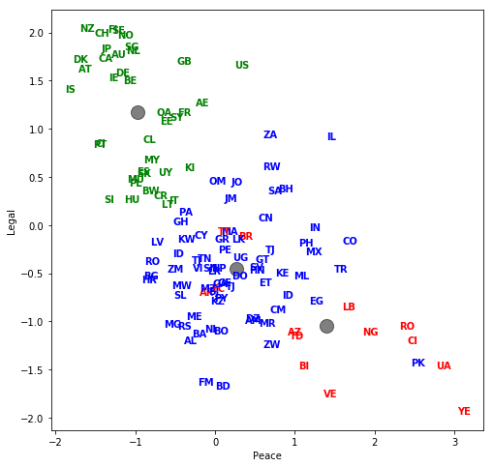
The three-cluster results
Green = Low country risk
Blue = Medium country risk
Red = High country risk

Slide 20
Cluster centers (scaled values) Note that high values for the peace index are bad whereas high values for the legal risk index are good
 | Peace index | Legal index | GDP
High risk | 1.39 | −1.04 | −1.79
Moderate risk | 0.27 | −0.45 | 0.36
Low risk | −0.97 | 1.17 | 0.00

Slide 21
ALTERNATIVE CLUSTERING APPROACHES Hierarchical Clustering
Start with each observation in its own cluster
Combine the two closest clusters
Continue until all observations have been combined into a single cluster (or since we have only k clusters)
Can be implemented in Python with AgglomerativeClustering.
Measures of closeness of clusters:
Average Euclidean distance between points in clusters
Maximum distance between points in clusters
Minimum distance between points in clusters
Increase in inertia (a version of Ward’s method)

Slide 22
ALTERNATIVE CLUSTERING APPROACHES Density-based clustering
Forms clusters based on the closeness of individual observations
Unlike k-means the algorithm, it is not based on cluster centers.
We might initially choose 8 observations that are close. After that we add an observation to the cluster if it is close to at least 5 other observations in the cluster, and repeat.

Slide 23
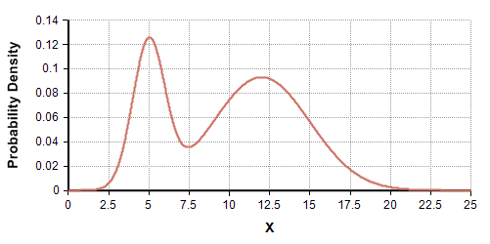
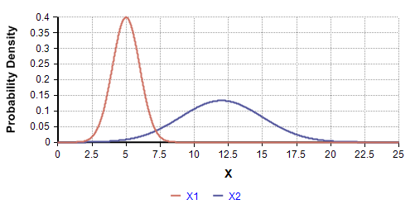
ALTERNATIVE CLUSTERING APPROACHES Distribution-based Clustering
Assumes that observations come from a mixture of distributions and uses statistical procedures to separate the distributions

Slide 24
REDUCE DIMENSIONALITY PCA - Principal Components Analysis
This is an approach to reducing the number of variables
PCA replaces a set of n variables by n new factors so that:
Any observation on the original variables is a linear combination of the n factors
The n factors are uncorrelated
The quantity of a particular factor in a particular observation is the factor score
The importance of a particular factor is measured by the standard deviation of its factor score across observations
The idea is to find a few variables that account for a high percentage of the variance in the observations

Slide 25
PCA – step by step
Standardize data with the Z-score scaling
Compute the variance-covariance matrix
Compute its eigenvalues and eigenvectors
Eigenvectors are the Principal Components. Higher is the eigenvalues, more important is the corresponding principal components.
The factor scores are the eigenvalues, and the SD of the factor scores are the square root of the eigenvalues itself.

Slide 26
Application to Country Risk Case
File countryrisk_PCA.xls © John Hull – Machine Learning in Business
 | PC1 | PC2 | PC3 | PC4
Corruption index | 0.594 | 0.154 | −0.292 | −0.733
Peace index | -0.530 | 0.041 | −0.842 | −0.086
Legal risk index | 0.585 | 0.136 | −0.431 | 0.674
GDP Growth rate | 0.152 | −0.978 | −0.141 | −0.026
 | PC1 | PC2 | PC3 | PC4
SD of factor scores | 1.600 | 0.988 | 0.625 | 0.270
% of variance | 64% | 24% | 10% | 2%

Slide 27
The first component explains 64% of the variability of data
The first and second component together explain 88%
The first, second and third component together explain 98%
Instead of exploiting unsupervised learning algorithms on 4 features, I can use the algorithm on 2 or 3 features (the first two or three Principal Components).
Therefore PCA is a tool often used in unsupervised (and supervised) learning to reduce dimensionality. To do so, we need a last step
LAST STEP: RECAST THE DATA ALONG THE PRINCIPAL COMPONENTS AXES
In the previous steps, apart from standardization, we do not make any changes on the data, you just select the principal components and form the feature vector, but the input data set remains always in terms of the original axes (i.e, in terms of the initial variables).
We now need to use the feature vector formed using the eigenvectors of the covariance matrix, to reorient the data from the original axes to the ones represented by the principal components (hence the name Principal Components Analysis). This can be done by multiplying the transpose of the original data set by the transpose of the feature vector.

